Slide 1
Year 12 2022 Subject Selection Information

Slide 2
Subject selection process for Year 12 2022: Requirements
Year 11/12 Student Course Manual 2021/22
SIMON - Knowledge Banks - Student Course Manuals.
Instruction sheet with online subject selection information (emailed).
You MUST book a meeting with the following staff if you not clear about requirements for:
VCE: Ms Rocard – VCE Coordinator
VET: Mr White – VET Coordinator
VCAL: Ms Campbell – VCAL Coordinator
thinking of changing your pathway from VCE to VCAL
You MUST book a meeting with Head of Senior School if you are:
changing any of your subjects in Year 12

Slide 3
Subject selection process for Year 12 2022: Requirements
Career Advisor (Wednesday 14 until Friday 30 July). Book an interview with Careers Counselors IF you are:
Unsure about your future directions
Unsure about the pre-requisites for tertiary courses.
First check the pre-requisites using SHC Kyneton Career Tools to obtain course information.
a. You can access Careers Tools via SIMON:
i. School Links
ii. Senior School
iii. VTAC Tools:
• VTAC Course search
• Prerequisite and Course Explorer

Slide 4
VCE Coordinator Ms Rocard

Slide 5
Victorian Certificate of Education (VCE): Minimum requirements
The minimum requirement is satisfactory completion of 16 units, which must include:
three units from the English group, including a Unit 3–4 sequence
at least three other sequences of Unit 3–4 studies, which can include further sequences from the English group.
The student will receive an S (satisfactory) for a unit if the teacher determines that the student has:
produced work that demonstrates achievement of the outcomes
submitted work that is clearly their own.
The College has an attendance requirement of 85% of classes to ensure the above is achieved and authenticated.
Notes:
As many of you will be aware, you need to satisfactorily complete 16 units in total to obtain your Victorian Certificate of Education.
Most of you will have gained “S’s” for up to 12 Unit 1 and 2 subjects by the end of this year which will contribute to this requirement.
However, you do also need to ensure you achieve 8 satisfactory units from complete Unit 3-4 sequences, including at least one from the English Group.
The policy at Sacred Heart is for students to be enrolled into at least 5 Unit 3-4 sequences (or 6 units if you have accelerated in Year 11). This is recommended for the majority of students as the additional sequence can increase your ATAR (which I will speak a bit more about shortly), it may also provide some insurance – just in case you get a Not-Satisfactory for one of your 3-4 Units.
To achieve an S for a unit students need to demonstrate the knowledge and skills required as determined by the outcome statement in the relevant Study Design. It is possible to achieve an S through completion of classwork as well as the level of achievement in a SAC task.
Attendance in the majority of classes is essential for you to be able to achieve your best and for teachers to authenticate that work completed is your own.

Slide 6
Victorian Certificate of Education (VCE): Study Scores
Each Subject will generate a score from the following:
Unit 3 (Graded Assessment 1)
Unit 4 (Graded Assessment 2)
Examination (Graded Assessment 3)
The combination of the Graded Assessments places students in a rank
All Study Scores are our of 50
Notes:
The big difference moving into your final year of VCE is that assessment (SACs, SATs & Exams) are all calculated to determine an individual Study score out of 50 for each subject. These scores are then used to determine your overall ATAR – Australian Tertiary Admissions Rank – this is then used by the Victorian Tertiary Admissions Centre (VTAC) to determine your eligibility and entrance into University. This video will provide a helpful overview:
https://www.vcaa.vic.edu.au/assessment/results/Pages/StudyScoreVideos.aspx

Slide 7
Australian Tertiary Admission Rank (ATAR)
Australian Tertiary Admission Rank (ATAR) is a number between 0.00 and 99.95 that indicates a student’s position relative to all the students in their age group
Allows the comparison of students who have completed different combinations of VCE courses
Used by institutions to rank and select school leavers for admission to tertiary courses
Other selection criteria may be used e.g. folios, interviews, ATAR plus folio, ATAR plus interview, UMAT
An ATAR of 80.00 means that you are in the top 20% of students from that year
Notes:
As mentioned the study scores from your Unit 3-4 sequences are used to calculate your ATAR which is a number between 0-99.95
The ATAR places you in a ranking with all students completing their final year of schooling in 2022.

Slide 8
Australian Tertiary Admission Rank (ATAR)
Eligibility for an ATAR in 2022 you must satisfactorily complete at least 8 units (10 or 12 preferred) of ATAR courses as a Unit 3/4 sequence. This equals 4 subjects and must include:
Satisfactory completion of a 3-4 sequence from the English group
The ATAR calculation is based on an aggregate of scaled study scores
Best of English, English Language or English Literature 3/4
Best 3 subjects of 3/4 sequence. VCE/VET scored subjects can be included.
The fifth and/or sixth VCE subject contributes 10%
Any unscored VET subjects contribute 10% of the fourth Study Score
A maximum of 6 subjects contribute to an ATAR
Notes:
Subject requirements to be able to obtain an ATAR are similar to the general requirements for gaining your overall VCE. That is a minimum of four Unit 3-4 sequences including and English subject.
The ATAR is calculated by combining the study scores from your Unit 3-4 sequences. Scores are scaled depending on the competition within the different studies throughout the State. I’ll show you a video shortly that explains this further – it will be particularly useful for you to if you a considering making any changes to your subject selection.
I mentioned before that our policy here at Sacred Heart is for the majority of students to complete at least 5 3-4 sequences. We also encourage those of you who are striving for a higher ATAR to complete 6 sequences. This is made possible through our acceleration program. The addition of a fifth and/or sixth 3-4 sequence will provide you with an additional 10% towards your ATAR. Historically, our data shows that students who complete 5 or more subjects consistently get higher study scores on average.

Slide 9
Notes:
Here’s another short video provided by VTAC to further explain how scaling works.
https://youtu.be/V5WoA2T4H3g

Slide 10
Examples of Grades and ATARS
Subject | Grade 1 | Grade 2 | Grade 3 | Study Score
Accounting | C+ | B+ | B | 30
Business Management | A | A | A | 37
English | B | C+ | C | 27
Further Mathematics | B+ | C+ | B | 31
Physical Ed | A | A | B+ | 36
Psychology | C+ | B | B+ | 31
This example has an average of B+ to A
Average study score of 34/50
ATAR = 70
Notes:
Here is an example of what study scores may look like based on different grades for different subjects. Please talk to your VCE teachers if you would like to know more about individual subjects, their assessments and scaling.

Slide 11
University Course ATAR requirements
Universities publish the minimum ATAR needed by the majority of Year 12 applicants from the previous year (2021).
Some University courses will require prerequisite subjects or study scores for entry. This may include:
Study scores of 25 for English
Science or Mathematical subject prerequisites
Many institutions offer programs for early entry schemes to some courses and will require additional research and applications.
Check the SHC Kyneton Career Tools portal
Ask at your Careers Interview
Check out any upcoming University Open Days and/or websites
Notes:
Briefly, you do need to be aware of prerequisites that might be required in addition to ATARs for some university courses. There are also a number of universities that have alternative or early entrance schemes that you can apply for – this means you can be accepted into a course without an ATAR.
The Careers Department will be providing you with lots of information next year, but in the meantime, check the Career Tools portal (Mr Matthews will show you a bit of it in this session) and the various institution websites. I’ve also noticed many of you making appointments with the Careers team – be sure to ask them to explain these options further to determine if they might suit you.

Slide 12
Year 12 VCE Considerations
SHC students undertake:
English Group (English, English Language or Literature)
Four other 3-4 sequences
Religion and Society (3 periods per cycle)
Study Block (6 periods per cycle)
**No more than two folio-based subjects is recommended as the workload is too great (Studio Arts, Vis Com, Production and Design-Textiles). Seek advice regarding this.
Notes:
Nearly to the end – This is the standard program for the majority of students next year. A study block in this context is three lessons per week – Supervised study is conducted in the Multi-Purpose Room – make sure you are organised to get work done during that time.
For those of you who are arty and are looking at folio subjects – we strongly recommend to do a maximum of 2 (Personally, I would recommend only 1) as they take up a great deal of extra time and can impact your ability to balance workload with your other subjects – (Folio subjects offered – Media, VisComm, Art, Textiles).

Slide 13
Year 12 VCE Considerations
Students can complete their VCE Non-Assessed, (no Study Score or ATAR).
No direct pathway into most Universities.
All Outcomes must still be achieved for the VCE Certificate.
Talk to Head of Senior School or VCE Coordinator if considering this option.
Notes:
One last thing! It is possible to complete what we call a Non-Assessed VCE – this simply means you do enough work to demonstrate the outcomes but you do not have to complete exams and therefore do not receive a study score for your subjects.
Without an ATAR you will not have a direct pathway to most Universities, however if you are considering other options such as apprenticeships, traineeships, or diploma level courses this may be an option for you.
You don’t need to make a decision about this until next year – basically you can decide any time up to the exams, however, there is a process to follow with Careers interviews, parent meetings and a clear pathway to employment arranged. Come and have a chat to Mr Matthews or myself if you think this might be an option for you.
Thanks everyone. Looking forward to working with you next year. I’ll now hand over to Ms Campbell to talk about VCAL.

Slide 14
VCAL Coordinator Ms Campbell

Slide 15
VCAL Considerations
Students would choose Second Year:
Literacy
Numeracy
WRS (Work Related Skills)
PDS/RE (Personal Development Skills)
Two ongoing VET Certificate subjects OR a School-based apprenticeship (SBAT)
End of Term Four 2021 VCAL students must have finalised work placements for 2022.

Slide 16
VET External Subjects & SBATs
All students completing a VET external subject or School Based Apprenticeship or Traineeship (SBAT) must email or see Mr White to discuss rollover for 2022
Enrolled in Traineeship (Hospitality or Retail) outside of the College contact Mr White and inform SPO, whether you are a VCE or VCAL student as this will contribute to both pathways.

Slide 17
Subject Selection Process Mr Matthews

Slide 18
Acceleration
Students wishing to take a VCE Unit 3/4 with studying the 1/2 in 2021 must:
Meet the criteria (4 subjects averaging 80% or above)
Follow the information found in the Operoo - Acceleration Application – Unit 1 & 2 or Unit 3/4 with a nominated teacher who will provide a recommendation.
Applications due: Monday 2 August at 5pm
Successful applicants will be notified by Monday 9 August, preference form changes will be made by Mr Matthews, Head of Senior School
Please see the relevant subject teacher for advice and information on suitability.

Slide 19
Career Interviews
Limited number of interviews starting from Wednesday 14 until Friday 30 July
Interviews are not compulsory for every student
Booking sheet is available in Careers from Tuesday 13 July
If considering moving into VCAL see Mr Matthews or Ms Campbell
If you are changing/enrolling in a VET subject for VCAL see Mr White

Slide 20
Career Support
Throughout the year Careers arrange information sessions for Universities, TAFEs & other Organisations (e.g. Defence Force) for Year 11 & 12 student
Courses
Early Entries
Scholarships
Pathways
Apprenticeships
Extremely beneficial
Information sessions will occur throughout the year
SHC Kyneton Career Tools

Slide 21
Career Support

Slide 22
Career Support

Slide 23
Online Web Preferences: Completion
Access to Web Preferences online is via email link sent out Thursday 15 July
Online Subject Selection is to be completed by Monday 2 August at 5pm.
Only five changes allowed before you are locked out, think carefully.
Check that you have filled the correct Online Section: VCAL or VCE, Year 12 and Unit 3/4

Slide 24
Online Web Preferences: Completion
New Unit 3/4 Subject:
If you wish to select a Unit 3/4 subject without having completed either Unit 1 or 2, you will need to complete an application to accelerate (Information on Operoo)
VCE/VCAL Change of Unit Form – Year 12 (hard copy) from Student Office (O’Neill) or SPO
Must see Mr Matthews to discuss subject change
Current teacher of the Unit 3/4 subject
Careers if required
Parent(s)/guardian
Return the VCE/VCAL Change of Unit Form – Year 12 to Mr Matthews by Monday 2 August, by 5pm
Timetable blocking will commence in August, late subject completion will not form part of the essential data and this may impact on your course running

Slide 26
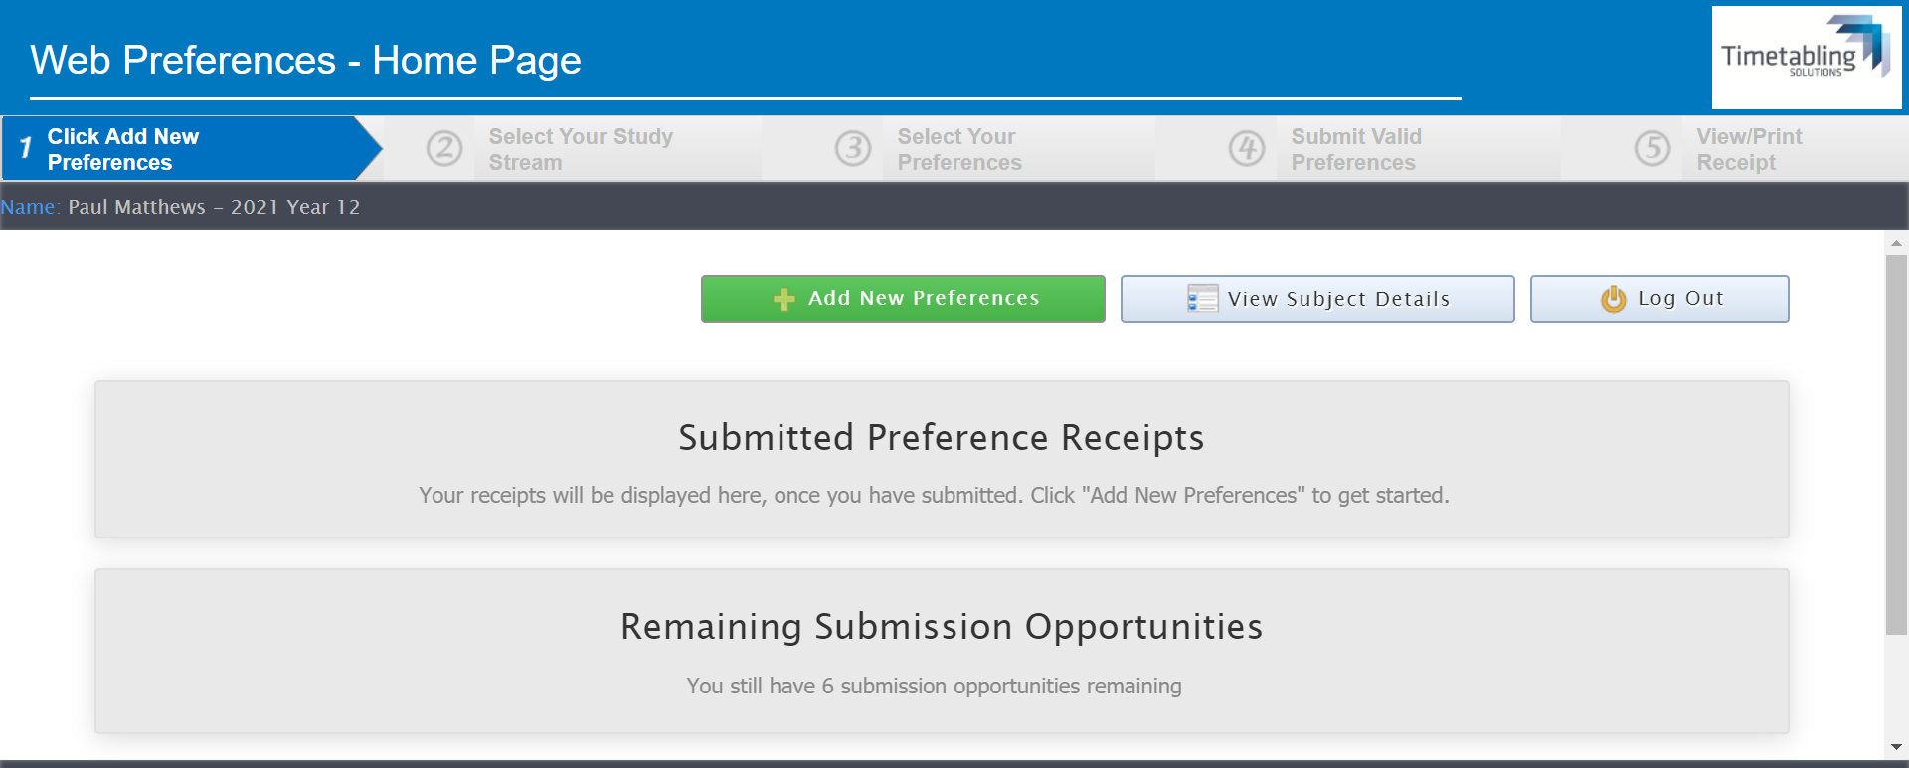

Slide 27
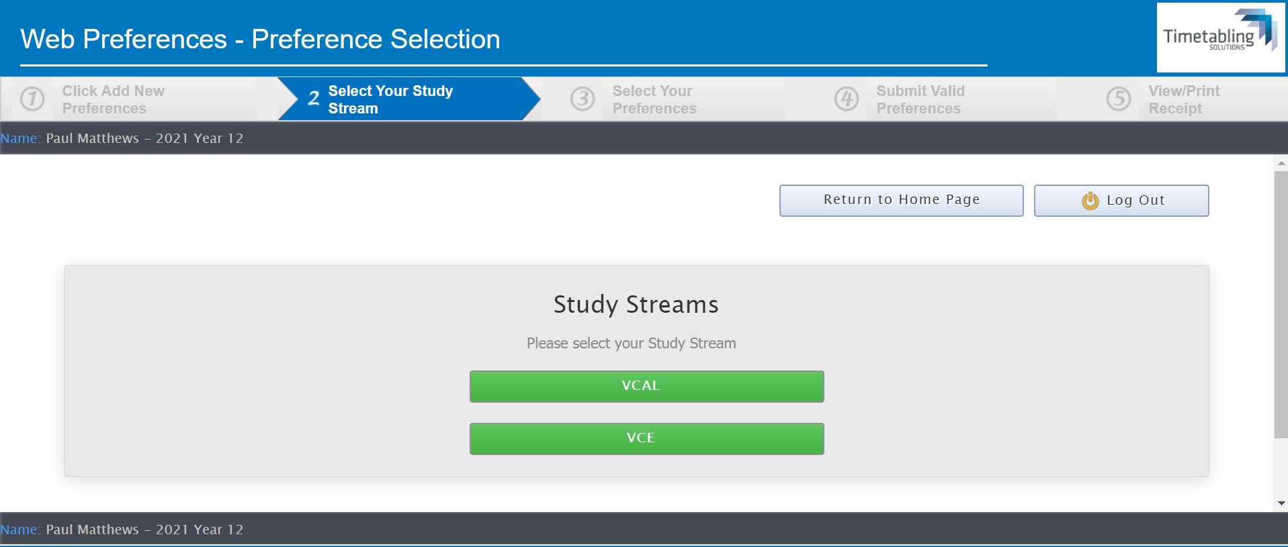

Slide 28
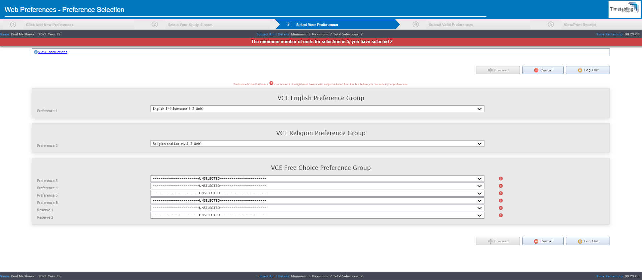

Slide 29
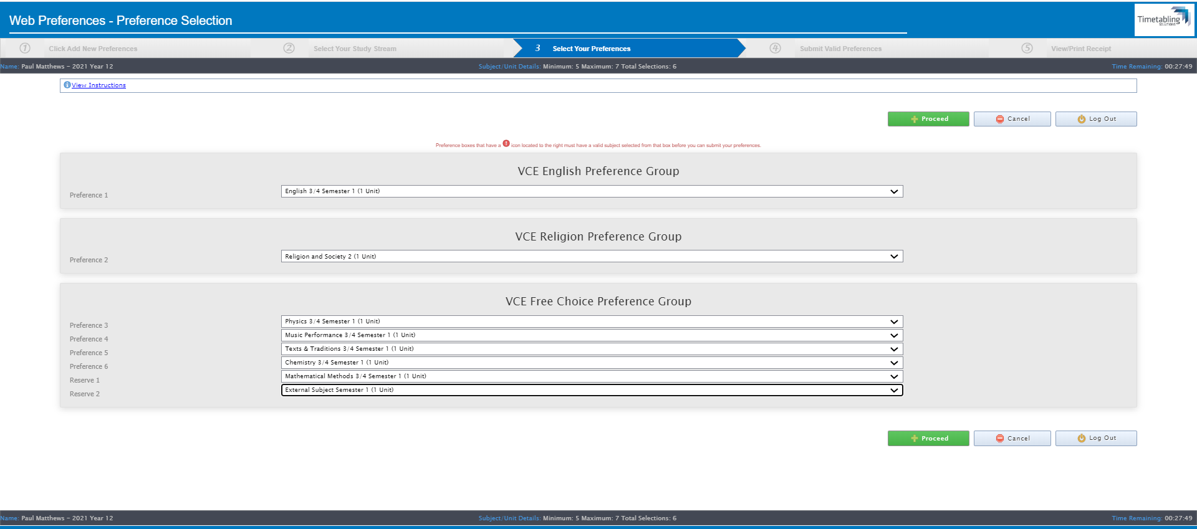

Slide 30
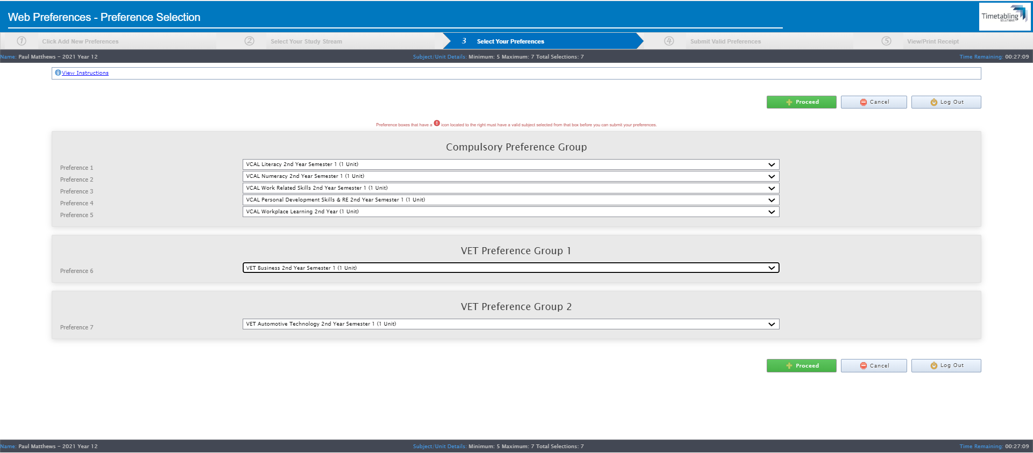

Slide 31
VCE/VET/VCAL 2022
Remember:
Online Subject Selection completed using the link sent to student email
Monday 2 August, by 5pm
Questions

